Slide 1
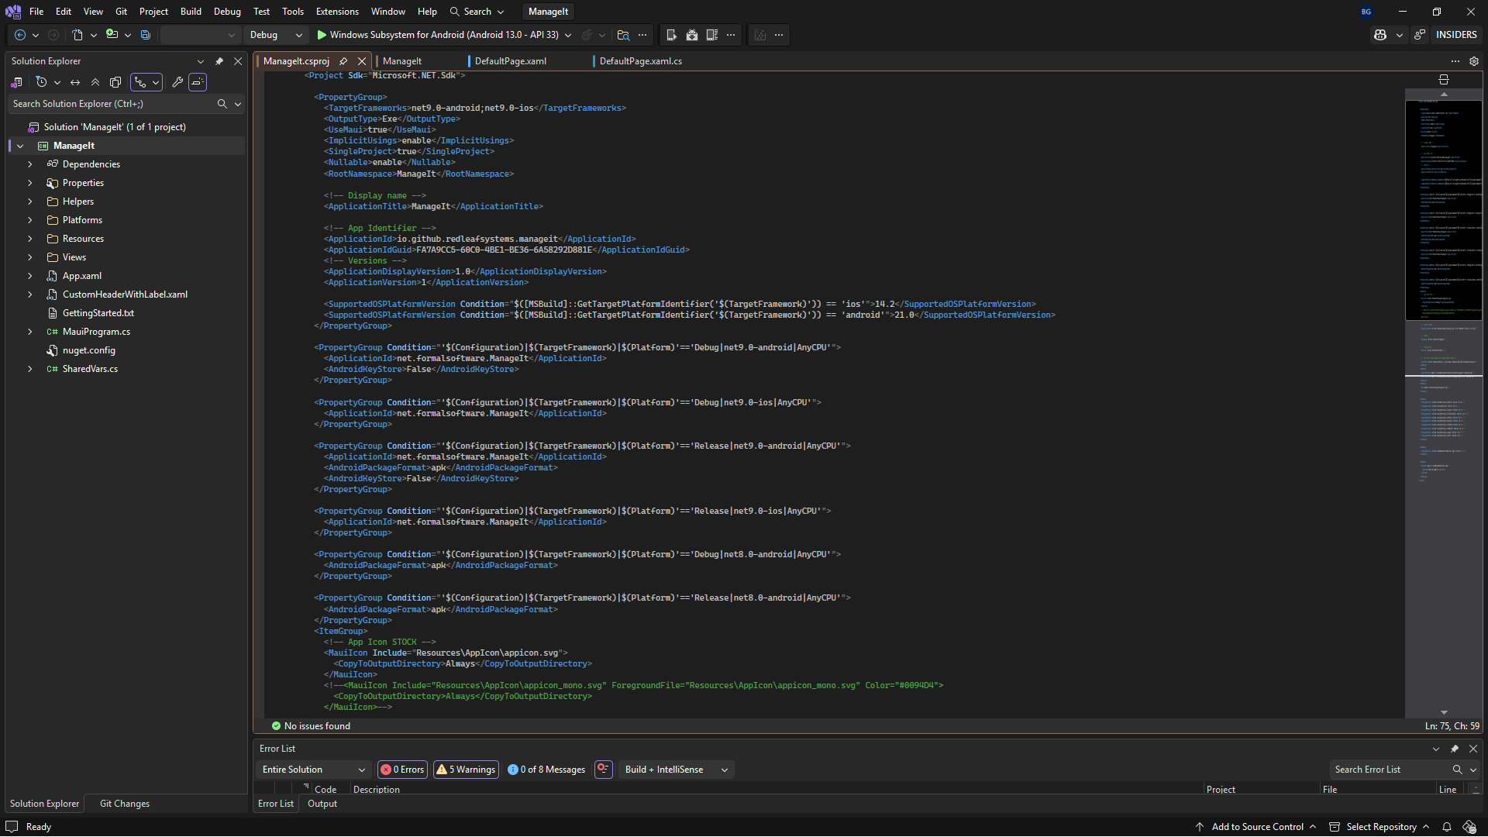
The project configuration code

Slide 2
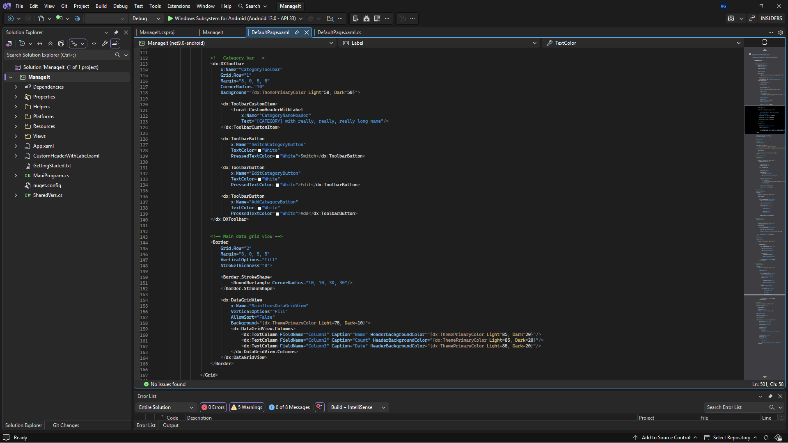
Code for the saved indicator bar and the grid of items

Slide 3
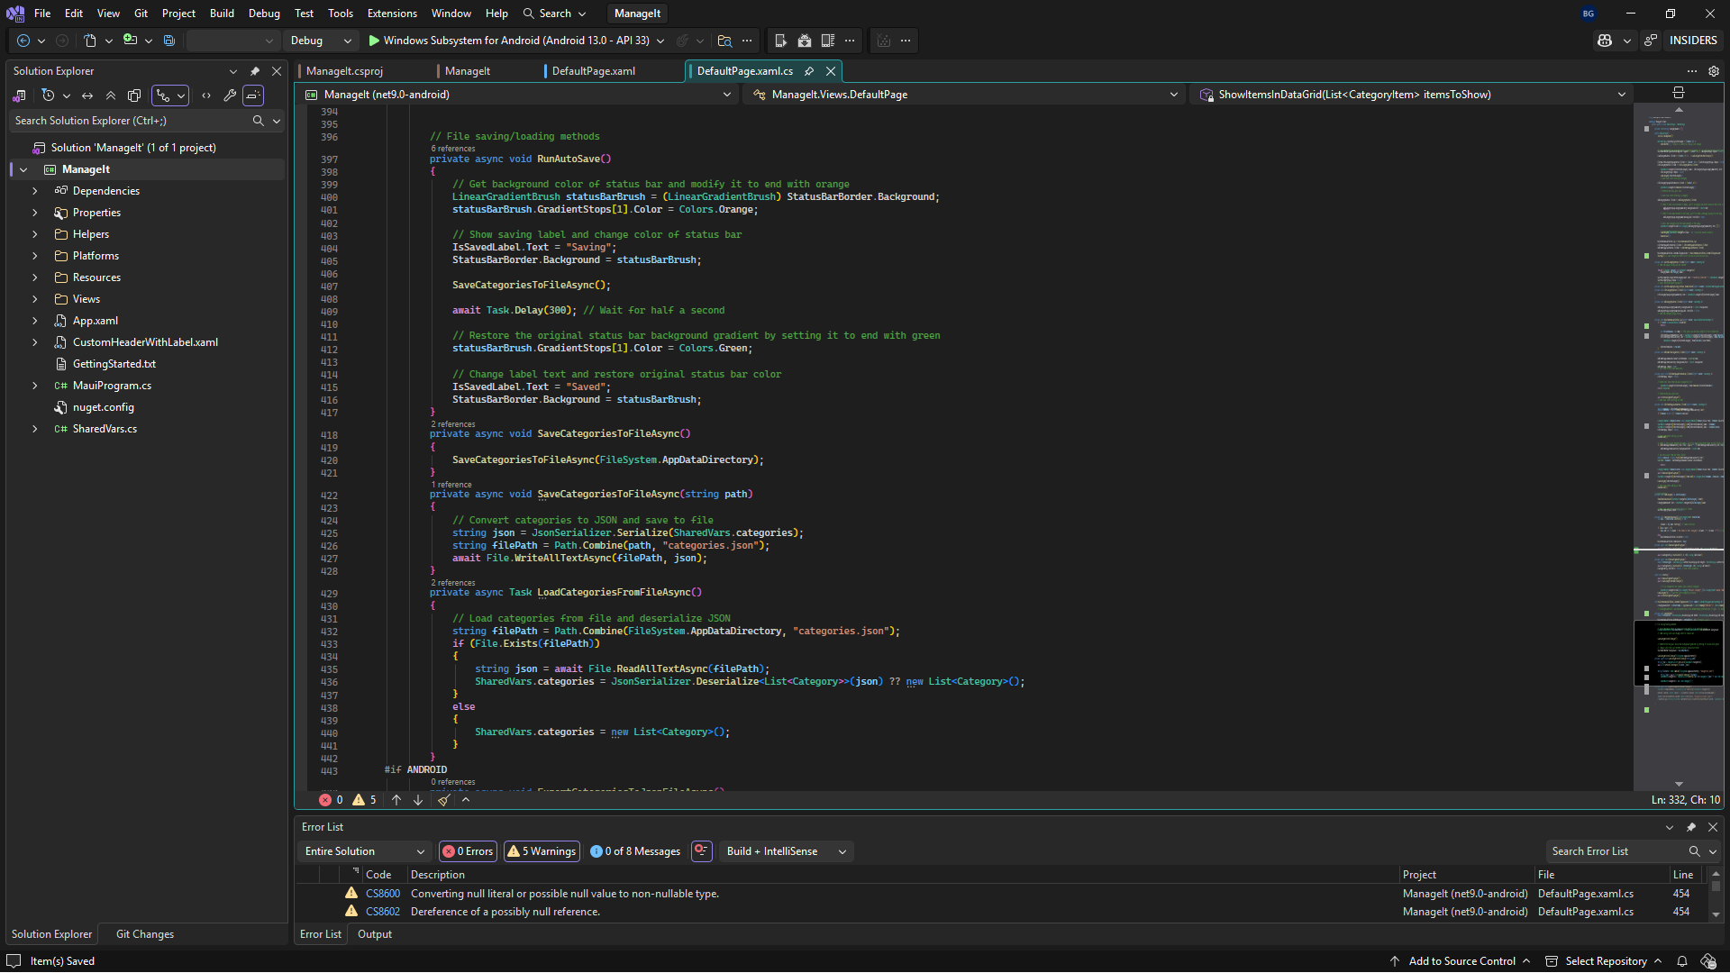
Some of the code used to automatically save the data

Slide 4
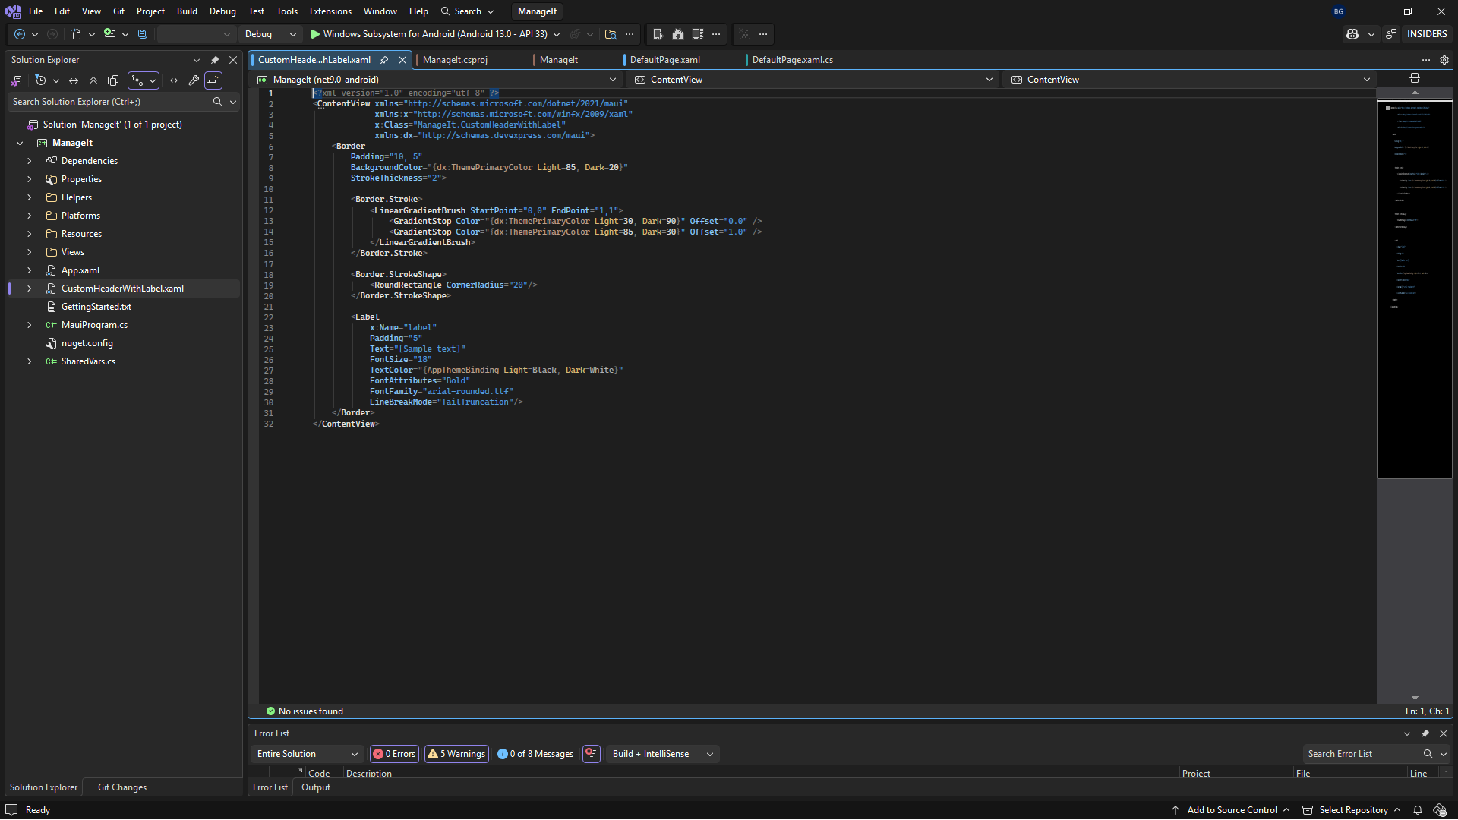
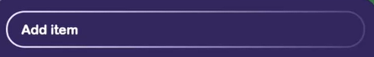
Code for my custom header, seen below

